Slide 1


Project Title: Security DMZ
(Demilitarized Zone)
Duration: 01/09/2025 – 30/09/2025 Organization: Sunbeam Institute Of Information Technology
Submitted by: Neha Sanjay Kumbharde

Slide 2

Agenda / Roadmap
Day 1 (04/08/2025): Database & Web Server Setup
Day 2 (05/08/2025):Flask App with SSL
Day 3 (06/08/2025): Mail Server
Day 4 (07/08/2025): Webmail Setup
Day 5 (11/08/2025):Monitoring with Nagios XI
Day 6 (13/09/2025):IDS with Snort
Day 7 (18/08/2025): Hardening & Firewall

Slide 3

Day 01 – Database & Web Server Setup Tasks: Setup DB + Web Server, Git clone application Steps: 1)Install MySQL/Postgres 2)Setup Apache2/Flask 3)Git clone repo

Slide 4

Day 02 – Flask App with SSL
Tasks: Access via https://todo.sunbeam.local
Steps: Generate SSL certs, configure Apache/Flask

Slide 5
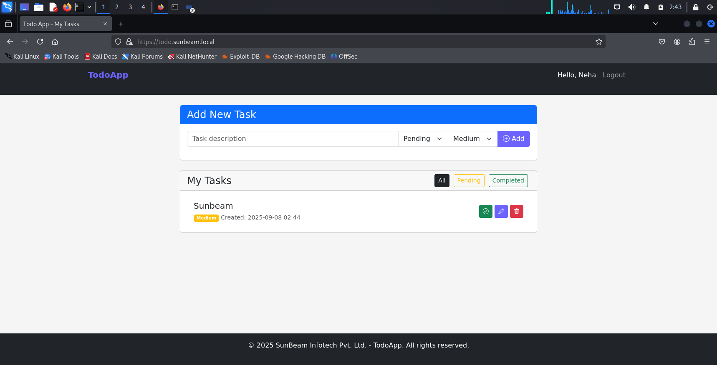
Engaging the audience
Make eye contact with your audience to create a sense of intimacy and involvement
Weave relatable stories into your presentation using narratives that make your message memorable and impactful
Encourage questions and provide thoughtful responses to enhance audience participation
Use live polls or surveys to gather audience opinions, promoting engagement and making sure the audience feel involved

Slide 6

Day 03 – Mail Server
asks: Install & configure Postfix/Dovecot
Domain: sunbeam.local
Created 2 users for testing
Domain: sunbeam.local
Created 2 users for testing

Slide 7
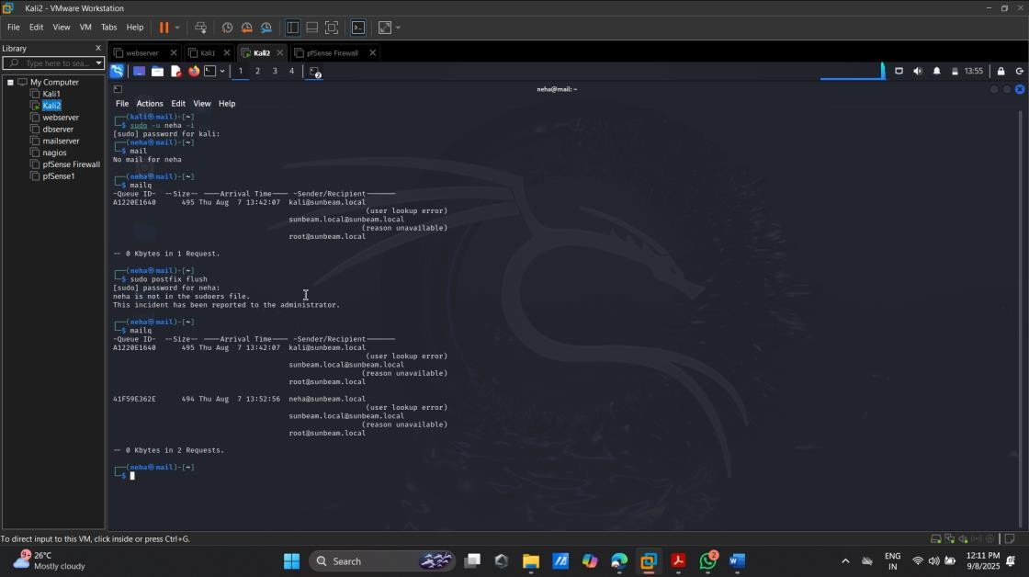

Slide 8
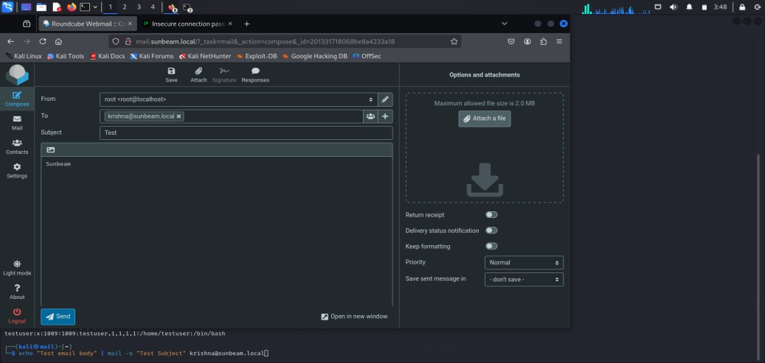
Day 04 – Webmail Setup
Tasks: Install Roundcube / Rainloop
Access via http://mail.sunbeam.local

Slide 9

Day 05 – Monitoring with Nagios XI
Tasks: Monitor HTTP, HTTPS, CPU, Memory, SMTP, IMAP, POP3
Configure Nagios XI alerts → send to sunbeam.local mail server

Slide 10
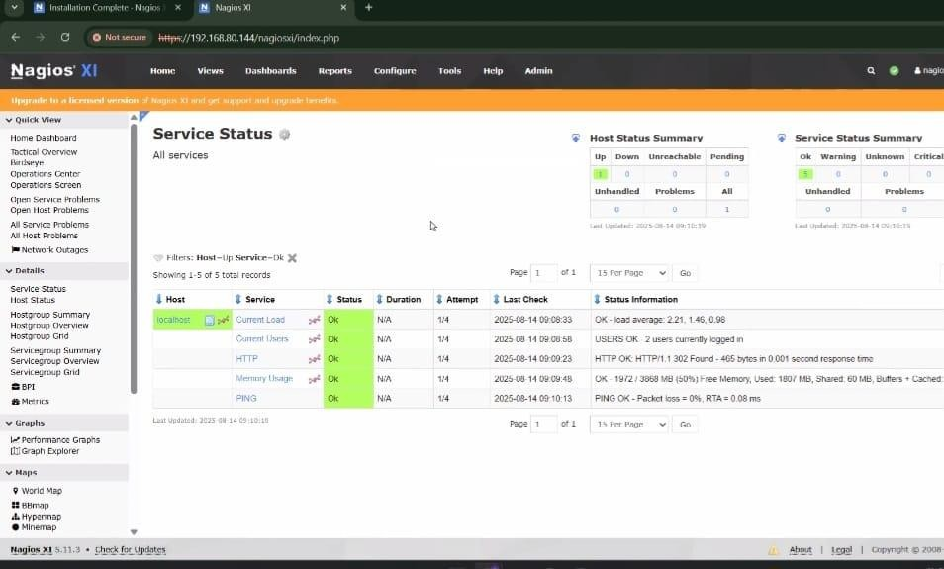

Slide 11
Day 06 – IDS with Snort
Tasks: Install Snort, write rules for SYN Flood, Ping Flood, Ping of Death
Objective:
Configure Snort on Web Server.
Write custom IDS rules.
Rules Implemented:
SYN Flood Detection
alert tcp any any -> $HOME_NET 80 (flags:S; msg:"SYN Flood detected"; threshold:type both, track by_src, count 20, seconds 1; sid:1000001;)
Ping Flood
alert icmp any any -> $HOME_NET any (msg:"ICMP Ping Flood detected"; dsize:0; threshold:type both, track by_src, count 50, seconds 2; sid:1000002;)
Ping of Death
alert icmp any any -> $HOME_NET any (msg:"Ping of Death detected"; dsize:>1500;
sid:1000003;)

Slide 12
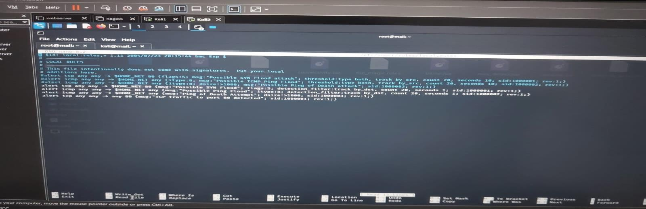

Slide 13
Day 07 – Hardening & Firewall
Tasks:
Fail2Ban for SSH protection
iptables on DBserver (allow only Webserver access)
pfSense firewall installation & configuration
Objective:
Protect all servers with fail2ban.
Secure DB server using iptables.
Install and configure pfSense firewall.

Slide 14
Thank you
Mirjam Nilsson​
mirjam@contoso.com
www.contoso.com

